Slide 1
Human Colour Perception and Colour Physics

Slide 2
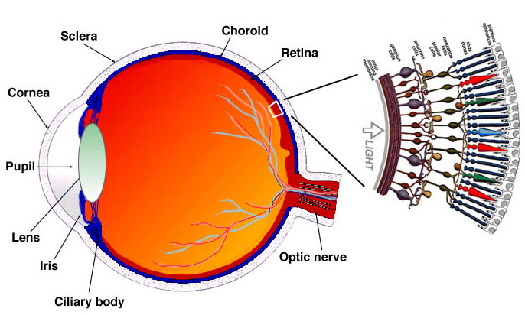
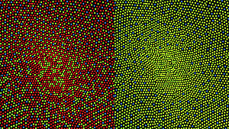
Human colour vision: Retina Structure
A Theory of colour vision
The trichromatic theory (Young–Helmholtz theory), proposed in the 19th century by Thomas Young and Hermann von Helmholtz, states that the retina's three types of cones are preferentially sensitive to blue, green, and red.
Fovea →
↑Drawing of a cross section of the human eye with a schematic enlargement of the retina
Illustration of the distribution of cone cells in the fovea (most sensitive area of retina) of an individual with normal colour vision (left), and a colour blind (protanopic) retina.
Note that the centre of the fovea holds very few blue-sensitive cones.

Slide 3
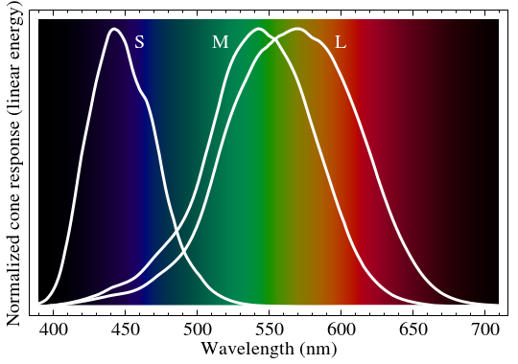
Human colour vision: Spectral Sensitivity
Physiology of colour perception
Perception of colour begins with specialized retinal cells containing pigments with different spectral sensitivities, known as cone cells. In humans, there are three types of cones sensitive to three different spectra, resulting in trichromatic colour vision.
The cones are conventionally labeled according to the ordering of the wavelengths of the peaks
of their spectral sensitivities:
short (S),
medium (M),
and long (L) cone types.

Slide 4
Human colour vision: LMS System
While the L cones have been referred to simply as red receptors, microspectrophotometry has shown that their peak sensitivity is in the greenish-yellow region of the spectrum.
Similarly, the S- and M-cones do not directly correspond to blue and green, although they are often described as such.
Rather, the perception of colour is achieved by a complex process that starts with the differential output of these cells in the retina and it will be finalized in the visual cortex and associative areas of the brain.
Therefore, the excitation level of the L, M and S cells (LMS System) do not correspond to the RGB (red-green-blue) system, it's not that easy…

Slide 5
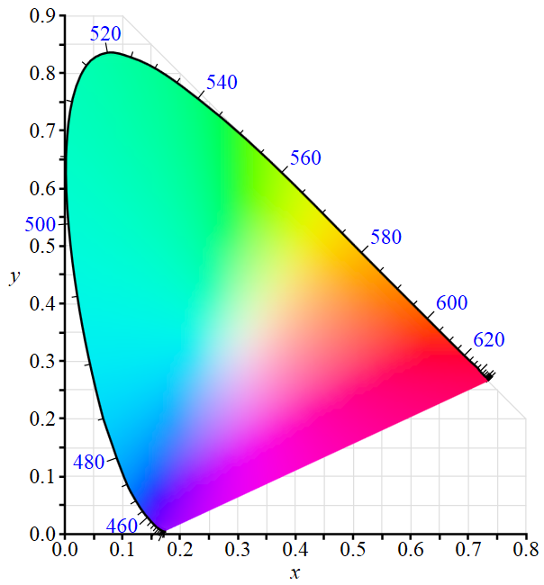
Path to physical colours: CIE 1931 XYZ colour space
First attempt to map and link all perceptible colours to physical wavelengths by CIE (Commission Internationale de l'Éclairage), using X (linear combination of cone response curves), Y (luminance = brightness) and Z (quasi-equal to blue).
Green LED
White LED
Red LED
Blue LED
Perceptible colours

Slide 6
Colour Physics: XYZ and RGB System
There are no simple devices producing colours from XYZ-coordinates directly.
However, there are simple devices emitting nearly pure spectral colours (LEDs).
XYZ-coordinates can be mapped to a combination of three spectral colours, usually red, green and blue (RGB).
There are many RGB colour spaces, based on different sets of wavelengths, one example is the CIE-RGB colour space with Red (700 nm), Green (546,1 nm), Blue (435,8 nm)
RGB is still an additive system (like the LMS and XYZ), for white, «all components must be at full scale».

Slide 7
Back to Perception: HSV System
While an additional colour system is preferable for emitting colours by hardware, it is often more natural to think about a colour in terms of hue and saturation rather than in terms of additive or subtractive colour components (HSV System).
Such a HSV color space can be obtained by transformation of an RGB colour space (and vice versa), and its components and colourimetry are relative to the RGB colour space from which it was derived.
Aside from the HSV space, there are other non-additive colour systems (not further investigated here).
https://en.wikipedia.org/wiki/List_of_color_spaces_and_their_uses, 2016

Slide 8
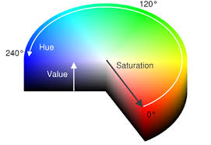
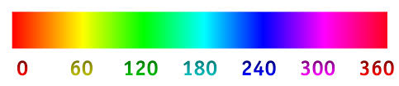
HSV: Hue, Saturation and Value
Value [0 … 1]
Saturation [0 … 1]
Hue [0° … 360°]
for Value=1 &
Saturation=1

Slide 9
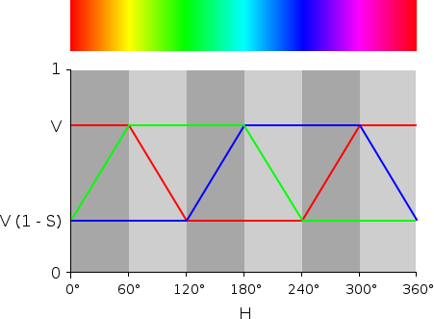
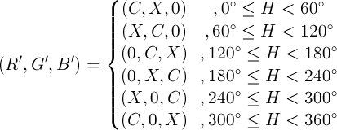
Example: HSV to RGB converter
With 0 ≤ H < 360°, 0 ≤ S ≤ 1 and 0 ≤ V ≤ 1, we get:
C = V × S (chroma value)
X = C × (1 - |(H / 60°) mod 2 - 1|)
m = V – C = V (1 – S)
(R,G,B) = ((R'+m)×255, (G'+m)×255, (B'+m)×255)
m=
R,G,B lie each in the range [0…255]
Sources: www.rapidtables.com/convert/color/rgb-to-hsv.htm
https://de.wikipedia.org/wiki/HSV-Farbraum

Slide 10
Your task: HSV to RGB+White Conversion
Your implementation must have a conversion from HSV to RGB+White.
One possible very simple way of implementing a HSV to RGB+White conversion is to use the “normal” HSV to RGB conversion with the intermediate values R’, G’, B’ for RGB and m for white.
However when the R,G,B is 1,1,1 this conversion will not achieve R,G,B,W=1,1,1,1 but R,G,B,W=0,0,0,1
m=

Slide 11
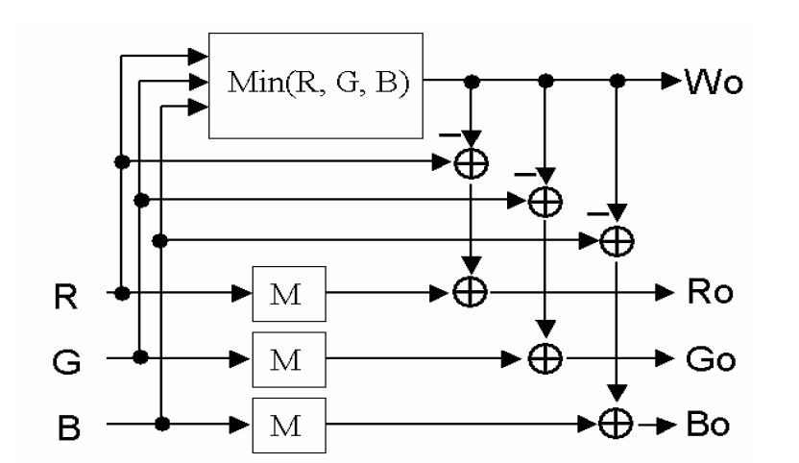


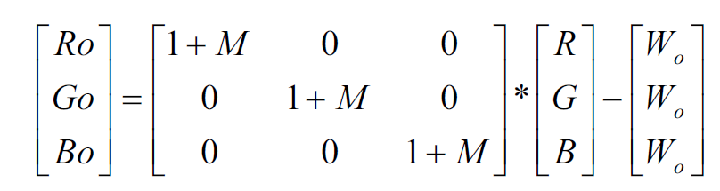
RGB to RGB+White Conversion
To get with an input RGB=1,1,1 an output of RGBW=1,1,1,1 with preserving HUE, Saturation, etc. you can use e.g. [1]
Example 1: With RGB=1,1,1 you get W_{o}=1, M=1 and R_{o}=1; G_{o}=1; B_{o}=1
Example 2: With RGB=0.5,0.7,0.8 you get W_{o}=0.5, M=0.625 and R_{o}=0.3125; G_{o}=0.6375; B_{o}=0.8
Literature
[1] Chih-Chang Lai, Ching-Chih Tsai, “A Modified Stripe-RGBW TFT-LCD with Image-Processing
Engine for Mobile Phone Displays”, IEEE Transactions on Consumer Electronics, 2007

Slide 12


RGB to HSV converter
First, the R,G,B values are divided by 255 to change their ranges from 0…255 to 0...1:
R' = R/255; G' = G/255; B' = B/255
Cmax = max(R', G', B'); Cmin = min(R', G', B')
Δ = Cmax – Cmin
Hue calculation:
Saturation calculation:
Value calculation: V = Cmax
Source: http://www.rapidtables.com/convert/color/rgb-to-hsv.htm

Slide 13
RGB to HSV converter & vice versa using MATLAB
Matlab offers two functions which converts RGB to HSV or vice versa.
The functions are named: hsv2rgb and rgb2hsv
Be aware that in these two functions all ranges of all values are [0 … 1], i.e.:
hsv2rgb([1/3,1,1]) → ans = 0 1 0
rgb2hsv([0.5,0,0]) → ans = 0 1.0000 0.5000

Slide 14
Literature
https://en.wikipedia.org/wiki/Color_vision, 2016
https://en.wikipedia.org/wiki/Retina, 2016
https://en.wikipedia.org/wiki/HSL_and_HSV, 2016
https://de.wikipedia.org/wiki/HSV-Farbraum , 2016
https://en.wikipedia.org/wiki/Color_vision , 2016
https://en.wikipedia.org/wiki/Primary_color, 2016
https://en.wikipedia.org/wiki/List_of_color_spaces_and_their_uses, 2016
Rafael C. Gonzalez & Richard E. Woods, “Digital Image Processing”, 3rd Edition, 2007

